Slide 1

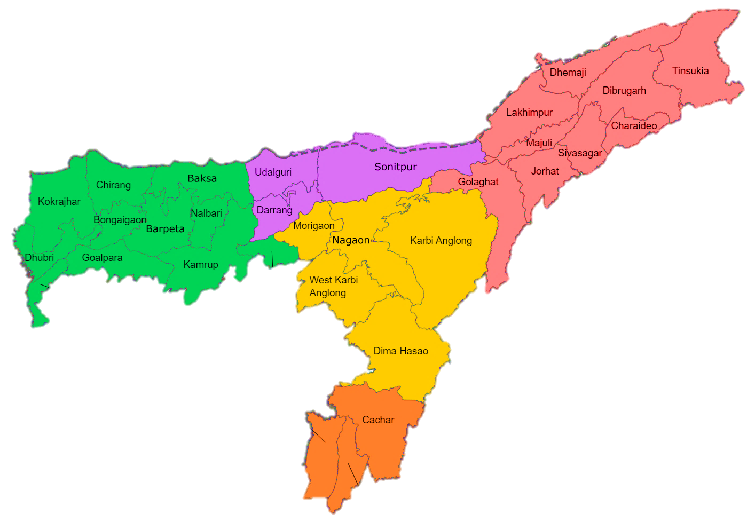
About the Total Strength
of
Assam

Slide 2
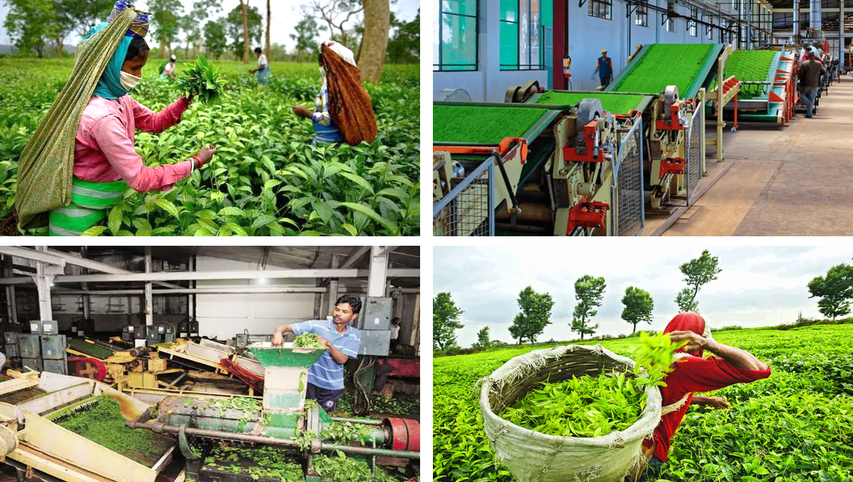

Assam Tea Industry
175 Years Old and 2nd Largest Tea Industry in the world

Slide 3


Petroleum Industry
135 Years Old and 3rd Largest Petroleum Industry in the world

Slide 4

Bamboo Plantation
1/3 of India’s Total Bamboo Production
The National Bamboo Mission (NBM) Govt. of India is taking robust steps to increase the Production and develop the Bamboo industry in Assam

Slide 5
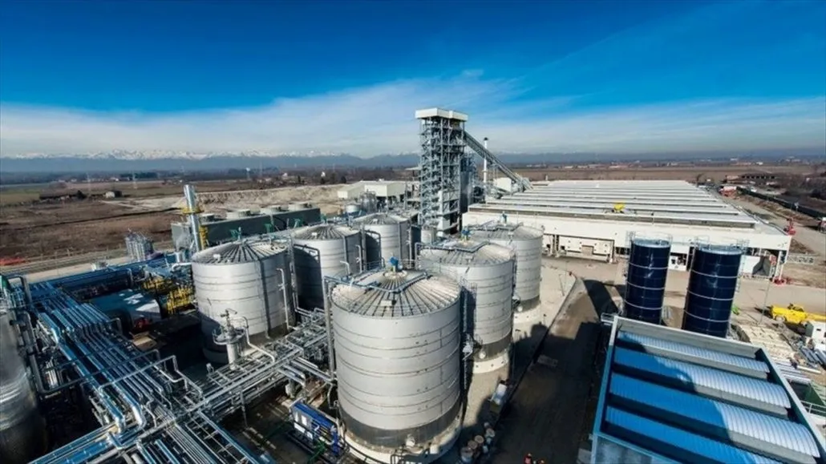
ABRPL (JV of NRL) – Worlds 1st & Largest Bio-ethanol Production Unit from Bamboo

Slide 6
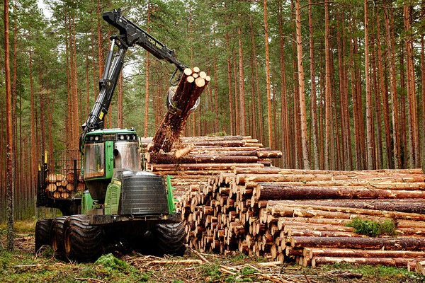
Timber Industry
One of the major industry after Tea & Petroleum
The Assam Govt. is working on reviving the Industry by introducing new policies

Slide 7

Silk & Muga Industry
In existence since the 17th Century
Assam Contributes 95% and 65% of country’s total Muga and Eri production respectively

Slide 8
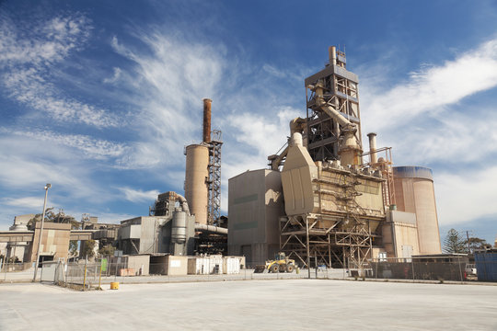
Cement Industry
10th Largest Cement Producing State in India

Slide 9

Tourism Industry
Contributing 5.5% to Assam’s GDP and providing 10.5% of total employment of the State

Slide 10

Bell Metal & Brass Industry of Assam
In existence since the 7th Century
2nd Largest handicraft sector after bamboo craft
Utensils made of Bell Metal & Brass are unique contribution towards Assamese tradition and culture carried for long period of time

Slide 11

Forest Cover of Assam
With a Forest cover of 26,832 sq. Kms, Assam boasts of a wide variety of rich forest based products

Slide 12
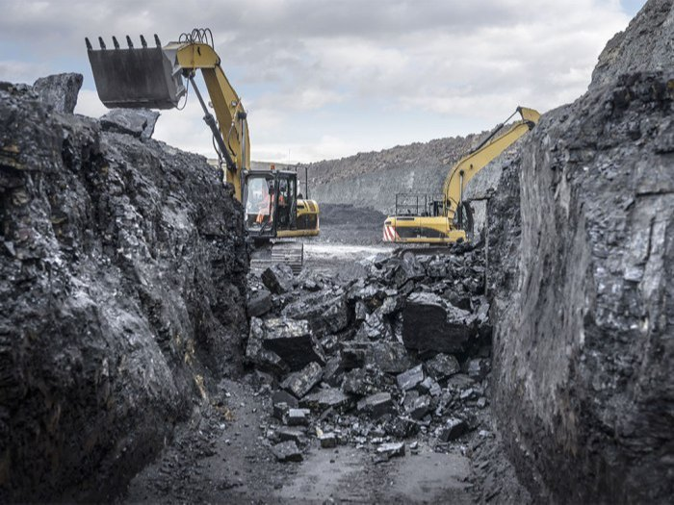
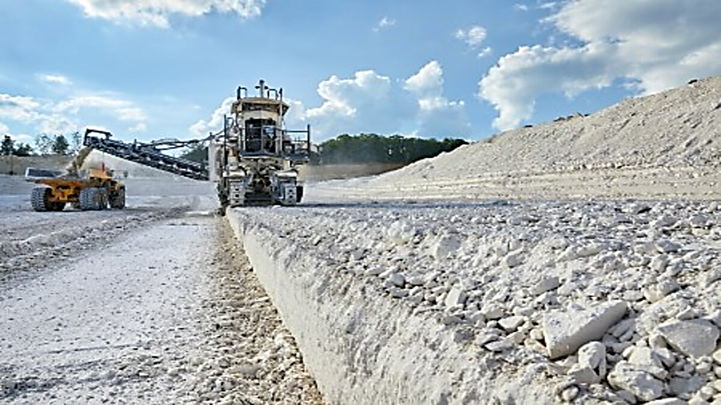

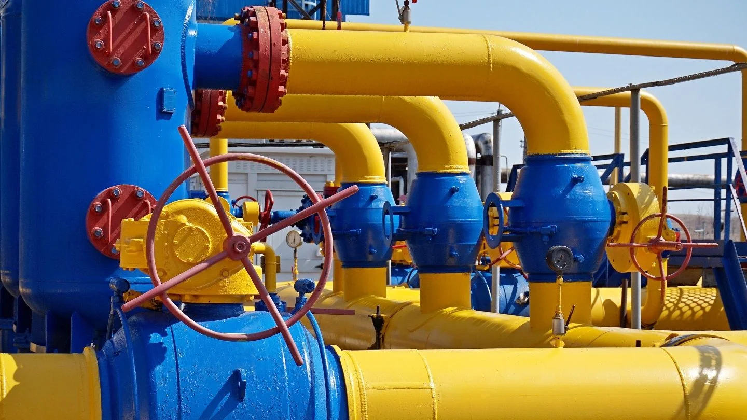
Natural Resources of Assam
Coal
Limestone
Natural Gas
Crude Oil
With 14% contribution, Assam is one of the largest Producer of Crude Oil in India
50% of India's entire onshore production of oil and natural gas`

Slide 13
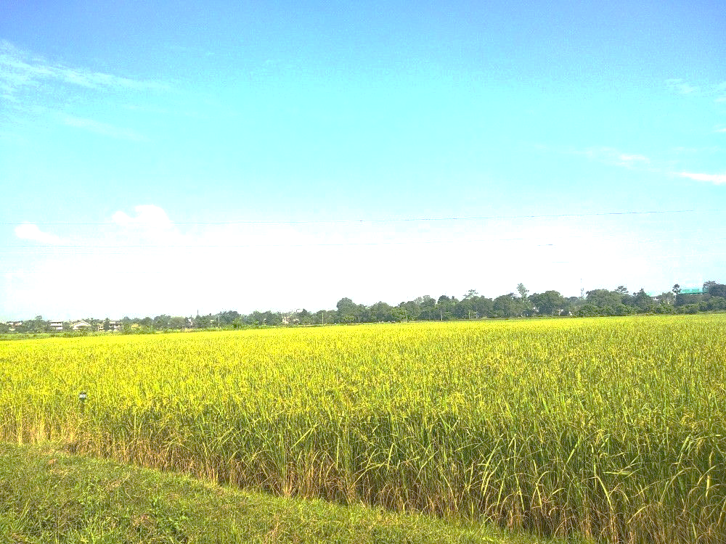
Agriculture in Assam
Total Land under Cultivation (Agriculture, Horticulture & Allied):
27.49 lakhs hectares
Cash Crop Area:
Tea: 46800 Ha
Jute: 66000 Ha
Field Crop Area:
Agriculture: 12 Lakhs Ha (Approx.)
Horticulture: 7.64 Lakhs Ha
Water Body Area:
3.64 Lakhs Ha
Bamboo Area Available:
2 Lakhs Ha (Approx.)
Total Farmers in Assam – 30 Lakhs (Approx.)
Approx. 85% Farmers are Small & Marginal spread in Rural Sector of 33 Districts of Assam

Slide 14
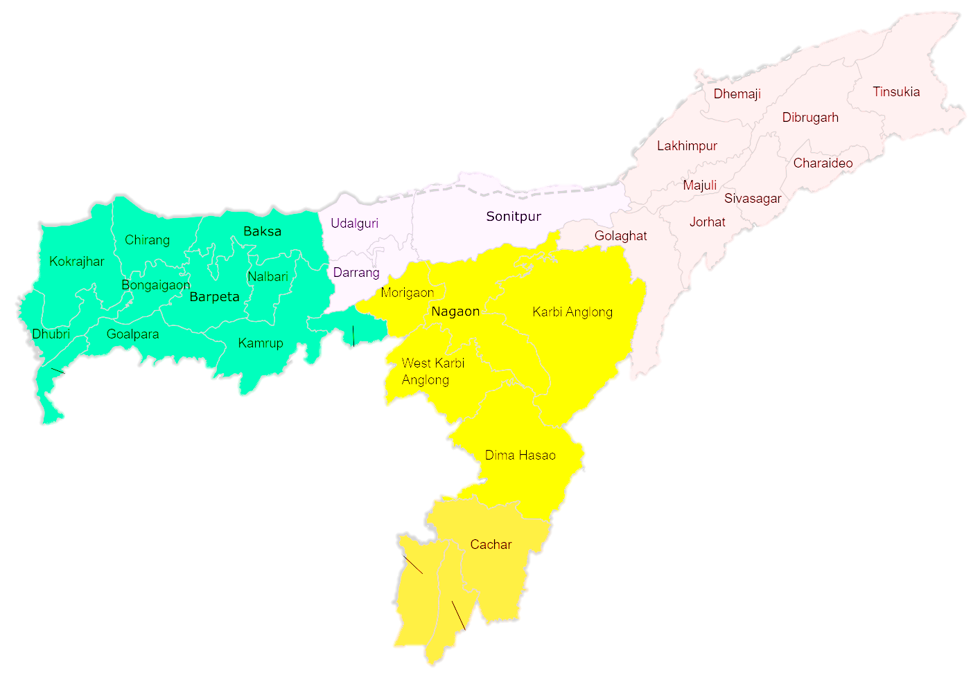
The Agriculture & Allied Sector in Assam consisting of approx. 85% Small & Marginal Farmers predominate the overall Production.
The Govt. of India has focused to organise, develop and strengthen the Sector by creating a total eco-system to get Bank linkage for an organised growth of this sector which has tremendous potential in a developing state like Assam.
Note: Bankers should come forward to develop the Agro & Allied Industry Sector the way they have helped develop the other big industrial Sectors in Assam

Slide 15
About the Other Strength
of
Assam

Slide 16
Culture of Assam
Assam is the meeting ground of diverse cultures
Over 750 years of rich cultural heritage
Literacy Rate in Rural Sector of Assam
66.37 %
Assam has many renowned eminent Literary Personalities
Sports
Assam has its foot print in the international sports arena
Developing fast in all the departments of Sports

Slide 17
Young Entrepreneurs in the Rural Sector
With an Avg. of 10 Lakhs population in all the Districts of Assam,
if we consider even 1 % as eligible for Micro & Small Entrepreneur, it come up to 10,000 per district
Gender equality
Assam has a unique feature of gender equality
Women can also participate equally in this Industrial growth
Financial Literacy
The Govt. of India has launched various initiatives to promote financial literacy and digital financial services have increased in popularity in the Rural areas as well.

Slide 18
Assam State Infrastructure including Rural Areas
Huge development has been made in the last 10 years:
Transportation Upgrades
Improved Road, Rail, Waterways, Air Connectivity
Electrification of Rural Assam
Information Technology integration
Education, healthcare, tourism and agriculture
Conducive biotic and abiotic factors of Rural Assam
Fertile Soil
Abundant rainfall
Favourable climate
Enhanced Agricultural Productivity
Potential for growth

Slide 19
Stable Government
Assam has a Stable Government for the last 10 Years
            Participatory,
            Consensus-oriented,
            Accountable,
            Responsive,
            Effective and efficient,
            Follows the rule of law
Insurgency Free
In recent years, there is no insurgency in the State of Assam which was there 10 – 15 years ago

Slide 20
Banking Network in Assam
Sl. No. | Name of the Bank | No. of Branches in Assam
1 | State Bank of India | 485
2 | Punjab National Bank | 360
3 | UCO Bank | 145
4 | Central Bank of India | 130
5 | Canara Bank | 125
6 | Indian Bank | 110
7 | Union Bank of India | 95
8 | Bank of Baroda | 70
9 | Bank of India | 50
10 | Indian Overseas Bank | 30
11 | Bank of Maharashtra | 10
12 | Punjab and Sind Bank | 10
 | Total Branches | 1620
Other Banks:
RBI – Regulatory perspective
NABARD
SIDBI
IDBI and
Other Private, Small Finance & Regional Rural Banks

Slide 21



Thank You
“Creating agribusiness for Development of the Rural Economy of Assam”
Associated Tea & Agro Management Services Pvt. Ltd.
6, Sadabor Avenue, 7th By-lane, Mother Teresa Road, Guwahati – 781021 (Assam)
www.atmsagro.org
contact@atmsagro.org

